Slide 1
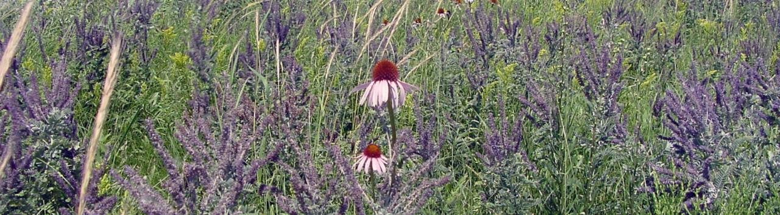


Prairie: History, Restoration, Enhancement
Greg Hoch / Prairie Habitat Supervisor
Steve Chaplin / Prairie Conservation Coordinator

Slide 2





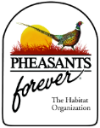




The Partners, a partial list

Slide 3
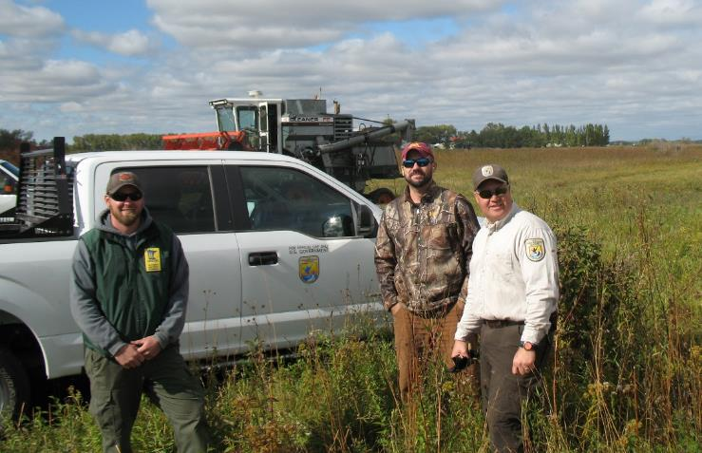
Agencies and NGOs working together

Slide 4
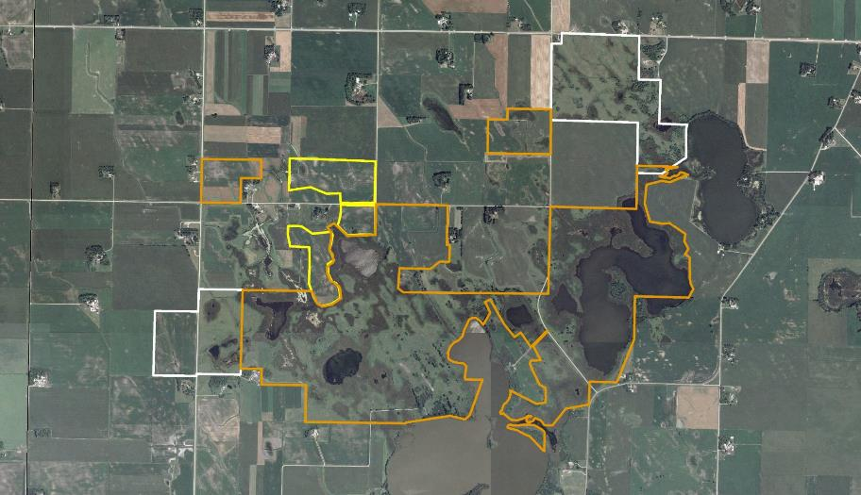








Partnership Landscape
Ras-Lynn WMA / Eagle Lake & Barber Lake WPA / WIA

Slide 5
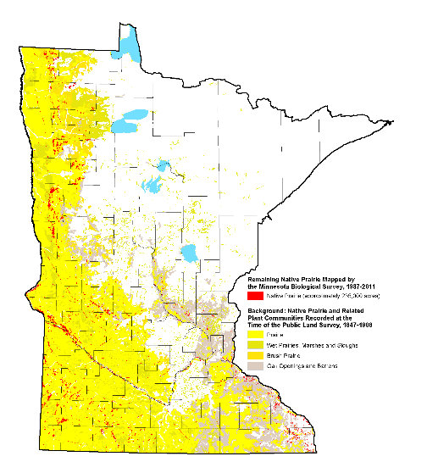
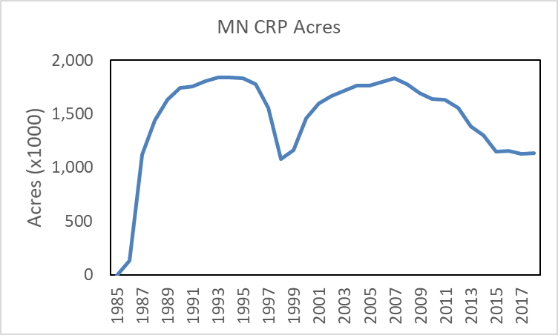
Remaining Prairie and Grassland Programs
Only 1.4% remaining
Conservation programs, like Soil Bank and CRP, temporary
Ups and downs of program support and funding
2019 State of the Birds Report (1970 to present)
forest birds – down 22%
shorebirds – down 37%
grassland birds – down 53%

Slide 6
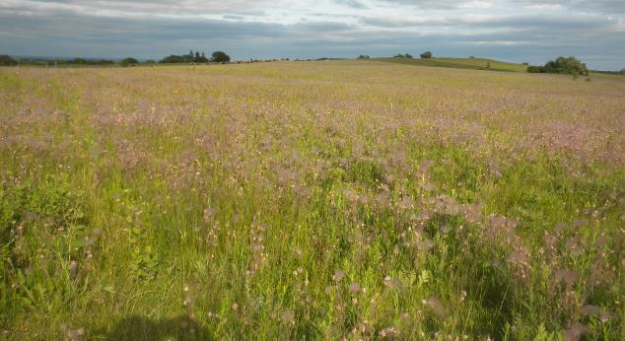
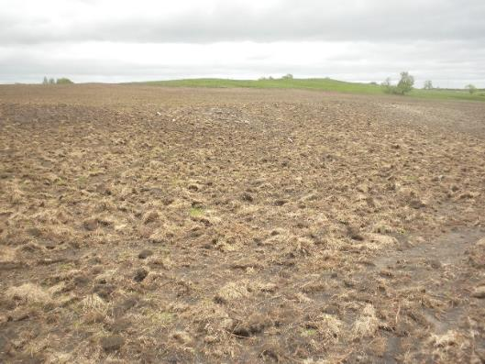
Only 1.4 % left and still losing 200 acres per year

Slide 7
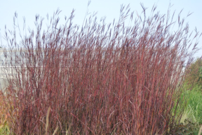
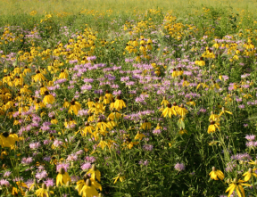
Much of the emphasis on grasslands is Restoration
HISTORY
Brome or brome/sweetclover
Native grasses (early CRP days) – seed origin?
Add a few forbs
40-80 forbs/grasses in seed mix
Local ecotype
WHAT / WHY RESTORING
Game species models – older, quick and cheap
Dense nesting cover (DNC) – will raise mallards
Add some forbs – will raise pheasants
Ecosystem models – newer, hard and expensive
Try to recreate the full diversity and function of native prairie
(which will create better game bird habitat!)

Slide 8
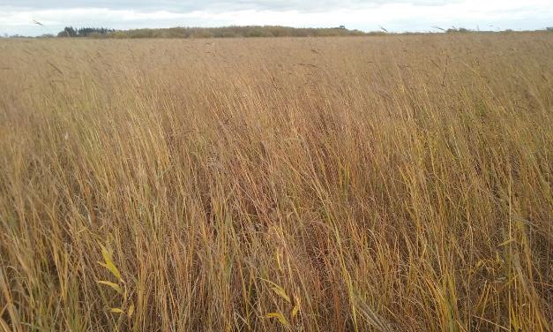
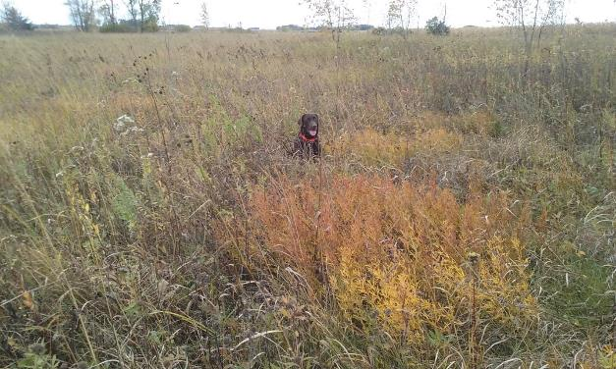
Tall, dense, thick (old) vs open and diverse (new)
Field Assistant at 15 feet
~2-3 plant species at my feet
~14-15 plant species at my feet

Slide 9
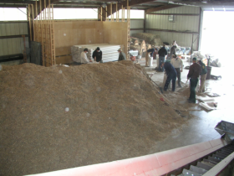
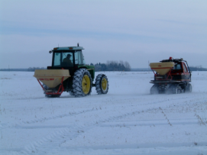
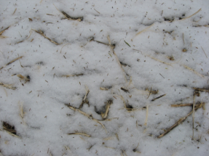
How we restore

Slide 10
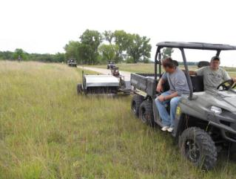
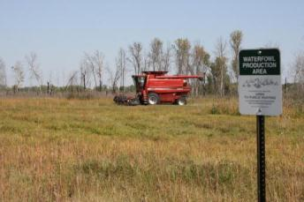
Seed Harvest
Hire local contractors to harvest DNR, FWS, TNC lands
Native prairie or well-established restoration
Purchase custom seed mixes from vendors
Prairie work is good for business!!
Agency staff

Slide 11
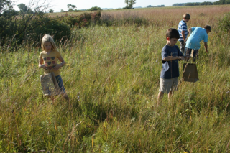
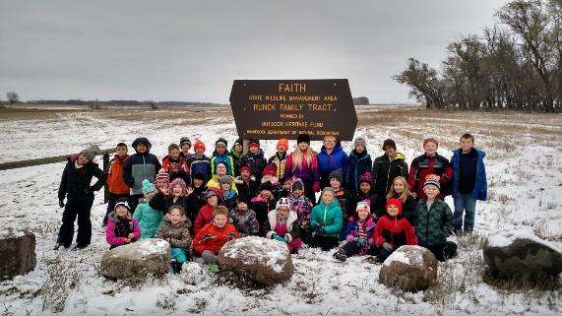
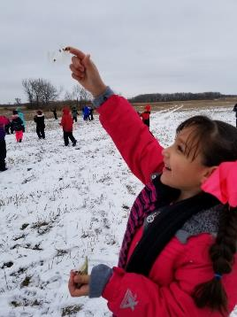
Oh I get by with a little help from my friends…

Slide 12
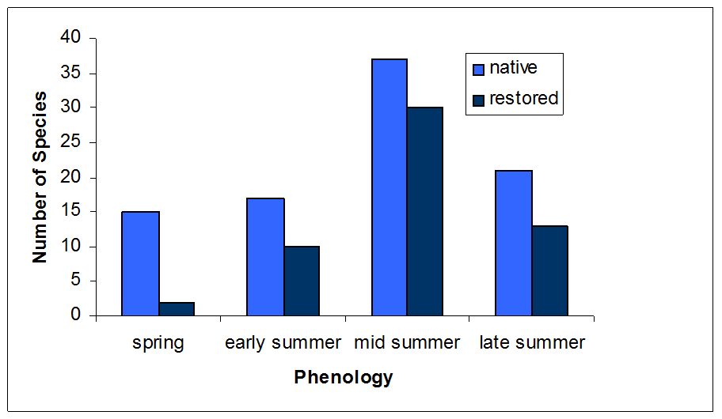
Making progress, but still things to learn

Slide 13
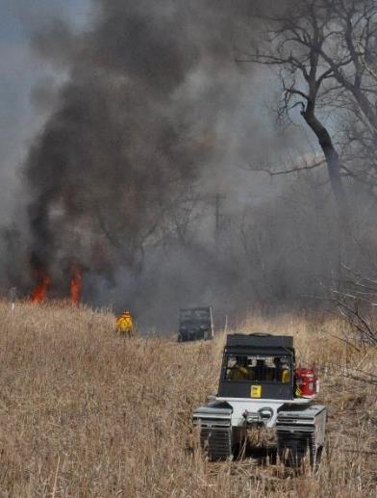
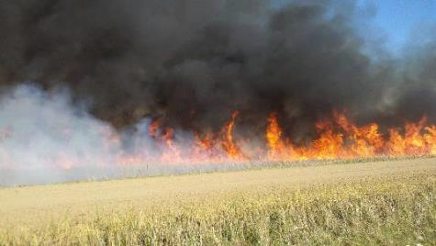
Enhancements - Fire
Removes thatch
Knocks back woody veg
Recycles nutrients
Stimulates plant growth
Mixed effects on insects

Slide 14
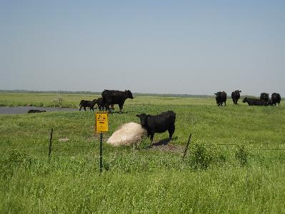
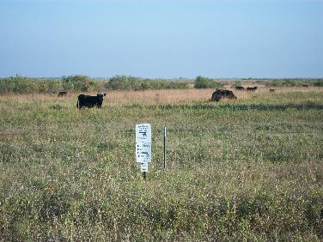
Conservation Grazing
Grazing increases plant diversity
increase insect abundance and diversity?
food resource for hens and chicks
Structural diversity
ungrazed – nesting
lightly grazed – brood rearing
grazed – displays / sunny areas to warm up
Cattail control
Range of wildlife species – meadowlarks to Henslow’s sparrow
Prairie chicken – need all cover types over year
Blue-winged teal nesting – grazing positive?

Slide 15
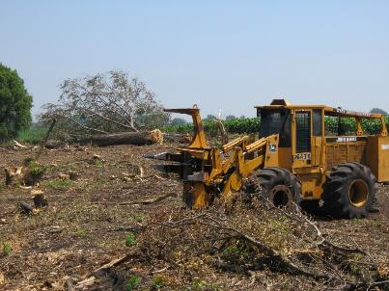
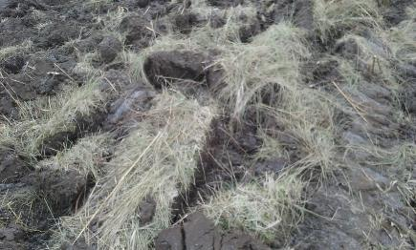
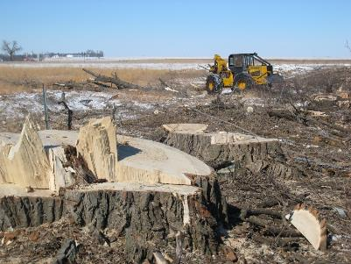
Restoration and Enhancement isn’t always pretty, or easy
Often delayed gratification
Benefits of enhancements come in following years
Some aspects of burning and grazing
Restorations often take 3+ years to ‘look good’

Slide 16
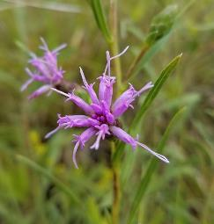
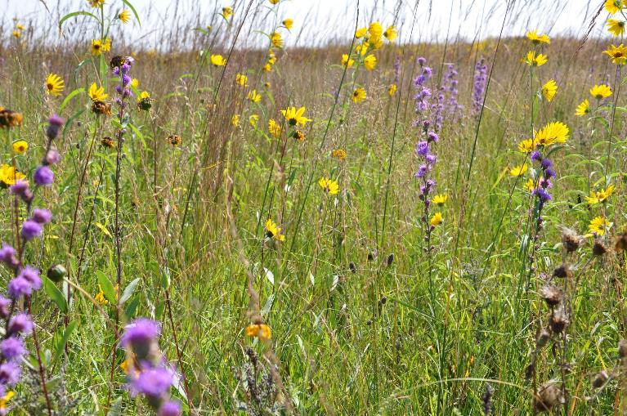
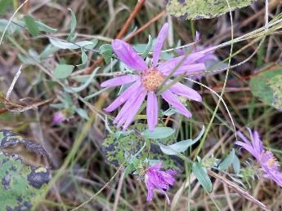
The Final Product Is Beautiful

Slide 17
Benefits Beyond Wildlife
Grasslands and wetlands store large volumes of rainfall and snowmelt
  Mitigate downstream flooding
Grasslands and wetlands remove nitrates from water,
  Make water safer
Grasslands and wetlands remove carbon from the air,
  reduce climate change
Grasslands reduce erosion keeping rivers and lakes cleaner
Grasslands and wetlands protect and recharge groundwater supplies

Slide 18
Benefits Beyond Wildlife 2
We have the science and data to demonstrate these ideas
Some of that research has come from Minnesota
Opportunity to take a grassland/wetland conservation message to a whole new audience to create wider support for these efforts
Grassland and wetland conservation is about more than pheasants and mallards

Slide 19
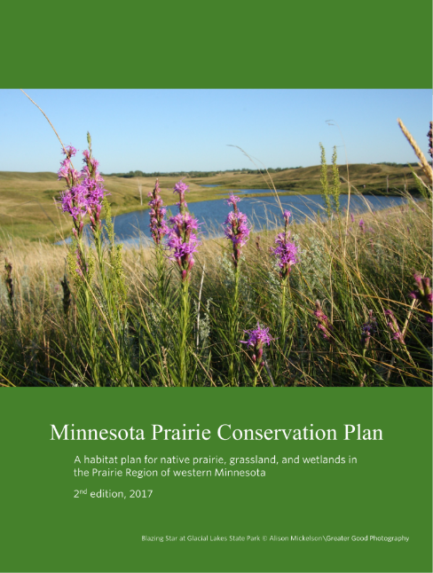
Minnesota Prairie Conservation Plan
  1st Edition 2010 (in response to the passage of Minnesota’s Clean Water, Land, and Legacy Amendment)
  2nd Edition 2017 (updated and revised every 5 years)
Approach is unchanged (core areas, corridors, agricultural matrix)
Major goals are unchanged
  Protect all remaining native prairie – Areas that are unplowed and still retain the appropriate native plant species
  (121,334 acres protected in 2010 to 129,467 in 2016)
  Create/maintain functioning prairie landscapes - Places large enough and connected enough to: 1) maintain viable populations of most native prairie animals and plants and 2) retain ecosystem functions (water, fire, pollinators, etc.)

Slide 20
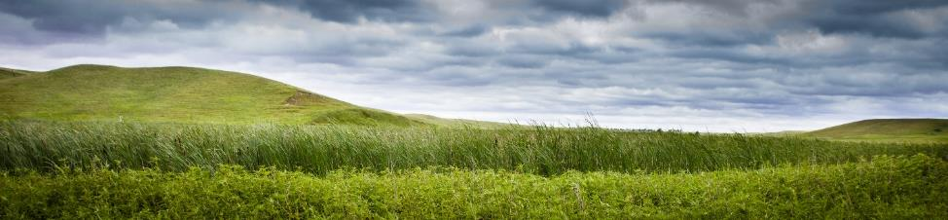
Prairie Core Areas
28 Core Areas, 2 million acres
3 new, 2 deleted, 14 combined into 6
All boundaries revised to better capture conservation landscape
Captures 77% of native prairie
Goal: 40% grassland, 20% wetland, 40% agriculture and other
Desired Outcome: Functioning Prairie Systems
Hole in the Mountain Prairie © Justin Meissen

Slide 21
Corridors and Strategic Habitat Complexes
Six new corridors provide better pathways for dispersal and open a connection to prairie areas in Iowa (2.0 million acres total)
Corridor complexes were redesigned, still 6,000 acres in size and 6 miles apart
Added 4 wetland complexes in iconic MN areas: Swan Lake, Heron Lake, Talcot Lake, and Agassiz NWR
Goal: 40% grassland, 20% wetland in SHC, 10% of each section in general corridors
Desired Outcome: Dispersal of prairie species along corridors ensuring viability of populations in core areas

Slide 22
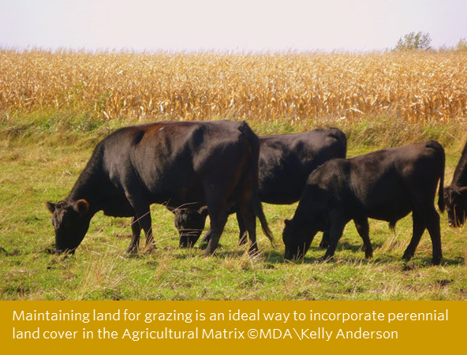
Agricultural Matrix
20.8 Million Acres
53 Major Watersheds
Goal: Maintain at least 10% of each major watershed in grassland or wetland, protect 5% through conservation easement or fee purchase (recognizing the conservation role of private grazing lands)
Desired Outcome: A more sustainable agricultural landscape with enhanced wildlife populations, a healthy grazing economy, improve water quality, and more water retention

Slide 23
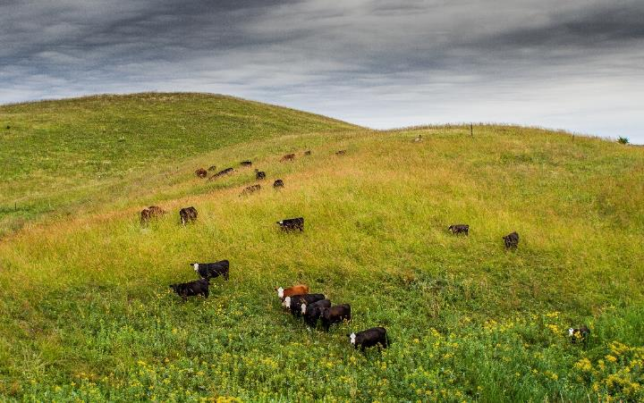
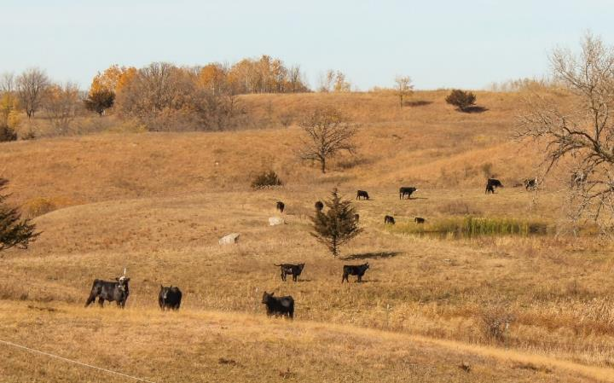
Conservation in an Agricultural Context
Maintain a robust grazing economy that utilizes both private and public lands
“Well-managed, private, working lands contribute to the viability of grassland and wetland systems and private income generated from grasslands can be the single largest driving force for grassland conservation.”
Key Question: Under what conditions can grass-based economic uses provide a superior return on labor and investment to sustain rural families and communities?

Slide 24
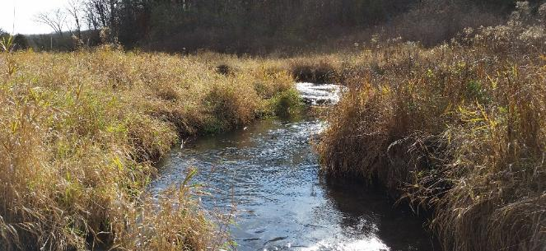
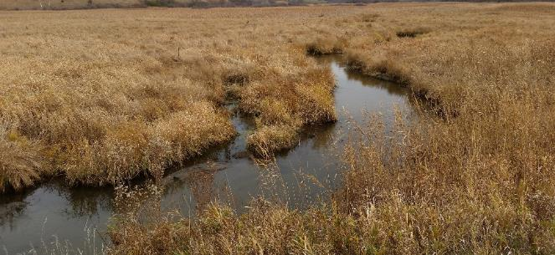
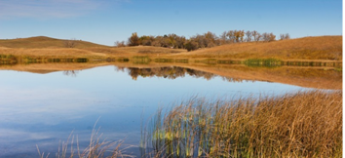
Aquatic Habitat and Water Quality Conservation
In core areas: Identify, protect, restore, and management the best examples of:
  Headwater streams, stream orders 1-2
  Mid-order streams, stream orders 3-5
  Large, Shallow lakes (>50 acres, < 15 feet deep)
  Large, Deep lakes (> 50 acres, >15 feet deep)
  Small lakes (<50 acres)
  Existing Permanent wetlands
  Existing Temporary and seasonal wetlands
  Fens and other special features
In corridors, strategic habitat complexes, and the ag matrix: undertake local projects to: create grassland/wetland complexes, increase stream buffers, expand perennial cover, and undertake more wetland restoration

Slide 25
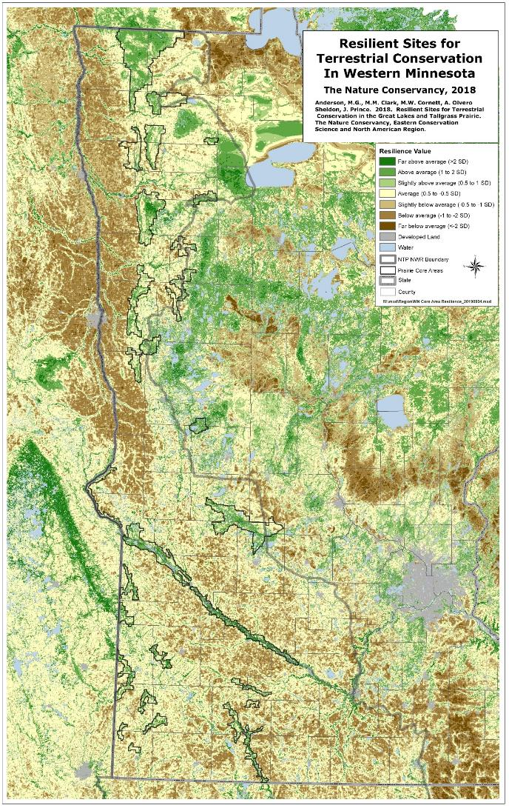
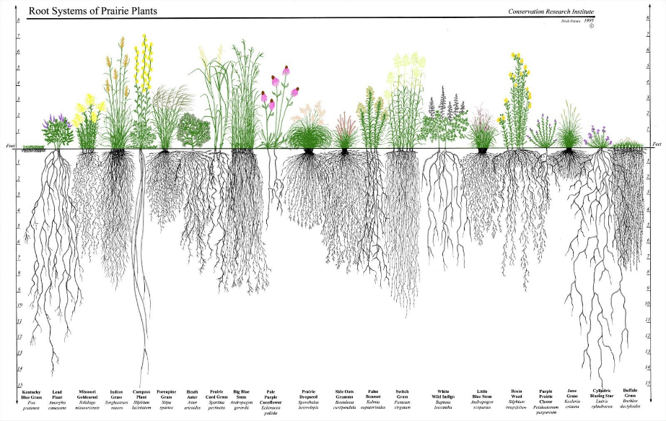
Prairie Conservation in a Changing Climate
Carbon Capture - 80% of prairie plant biomass is underground, roots reach >10 ft, O2 and decomposition decrease with depth, carbon in deep roots retained longer
Adaptation to Change - Each prairie species will react differently to the changes but are most likely to survive when they have 1) pathways to move within and 2) places to go to with high climate-change resilience (i.e. natural vegetation and a high diversity of environmental conditions).

